Slide 1
Log Analytics Overview
Name

Slide 2

Azure Monitor
Full observability for your infra, app and network
Metrics
Logs
Common Store
Unified Monitoring
Data Driven Insights
Workflow Integrations
A common platform for all metrics, logs and other monitoring telemetry
Advanced diagnostics and analytics powered by machine learning capabilities
Rich ecosystem of popular DevOps, issue management, SIEM, and ITSM tools

Slide 3



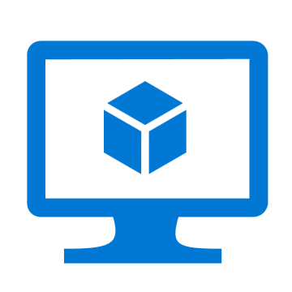
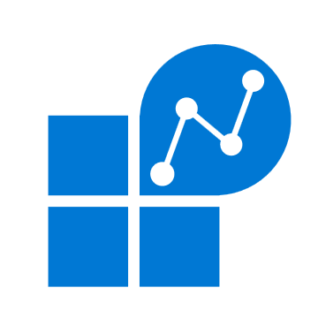










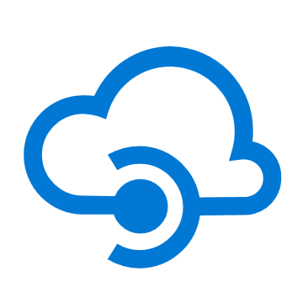
Unified Monitoring
Azure Monitor
Insights
Application
Containers
VM
Monitoring Solutions
Application
Operating System
Visualize
Metrics
Dashboards
Views
Power BI
Workbooks
Azure Resources
Azure Subscription
Analyze
Metrics Explorer
Log Analytics
Logs
Azure Tenant
Respond
Custom Sources
Alerts
Autoscale
Integrate
Event Hubs
Logic Apps
Ingest & Export APIs

Slide 4
Azure Monitor for VMs - Preview

Slide 5
Challenges in VM Monitoring
Hard to…
Figure out what and how to Monitor
“The scenario I am imagining is in an Ops room, with a large screen, where we can see at a glance on multiple graphs how all VM's are performing in terms of CPU, Mem, Disk, Network etc.?”
Disambiguate the issues in the VM, caused due to its usage or Azure itself
“We had a process that was putting everything at a standstill – we had high latency due to a poorly scheduled process that was taking up bandwidth. Show me all the processes running on the servers, and show how much they're trying to transmit.”
Troubleshoot how guest-level resource constrains impacts workloads/apps
Identify VM hotspots at scale based on resource utilization
“It’s too difficult to wire together all the diagnostics for memory. I can always RDP into boxes, but I want to see it automatically.”
Determine whether how back-end dependencies are affecting clients
“I need to know how VMs from my customers communicate.”
Determine health and availability of Azure VMs across Resource Groups

Slide 6
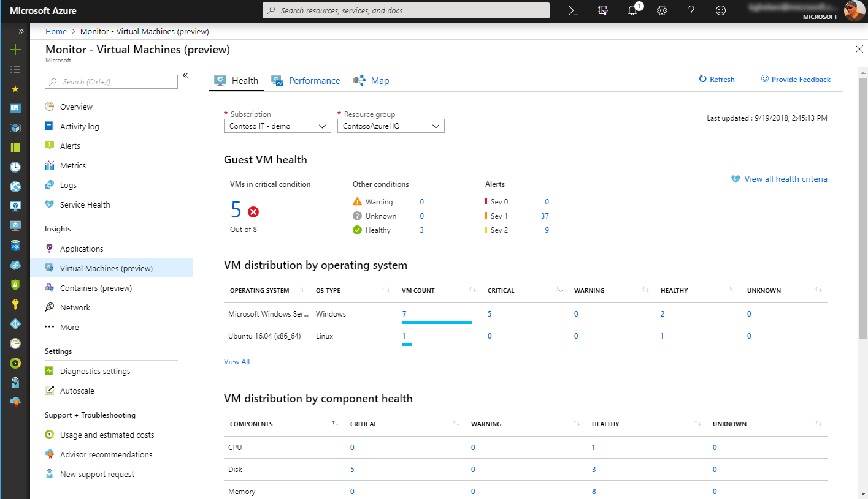
Azure Monitor for VMs
Health Diagnostics
Pre-defined health monitors to jump-start VM monitoring
Near real-time monitoring of core VM components (CPU, Memory,..)
Health diagnostics, that helps to localize the issue fast
KB articles on common causes and resolution
Customizable alerting thresholds on health monitors

Slide 7
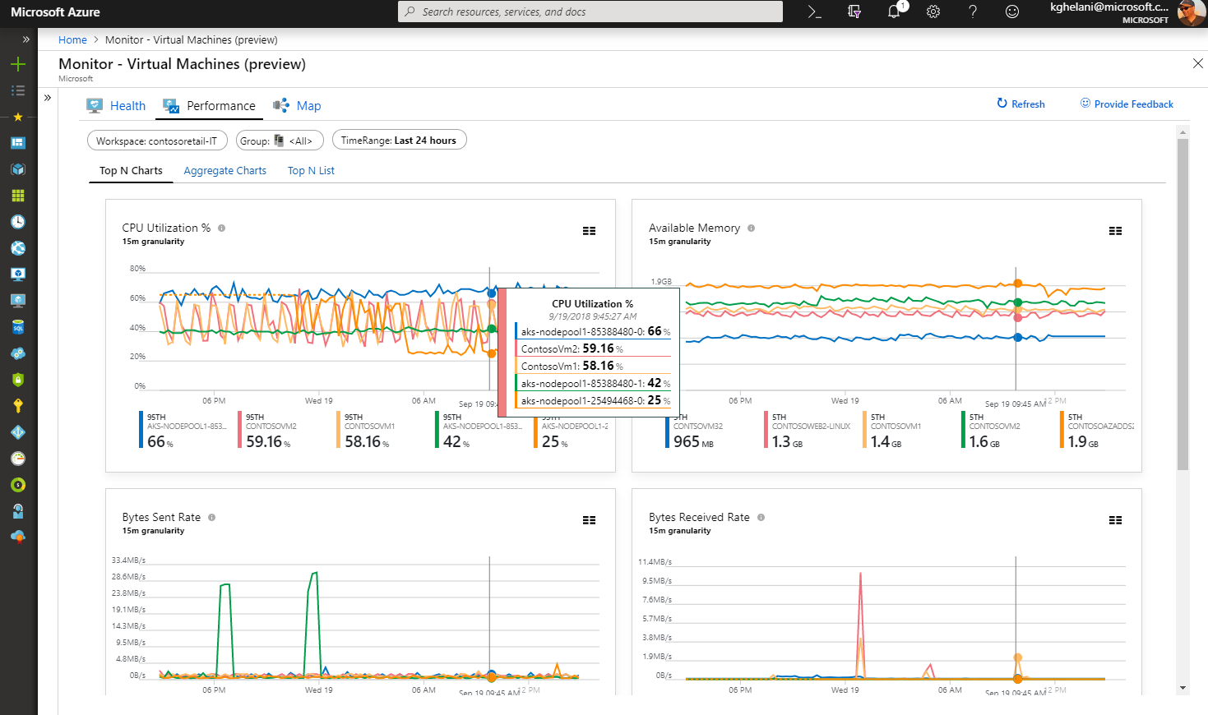
Azure Monitor for VMs
Performance
Aggregation of VM metrics across thousands of VMs
Top N performance views identify resource constrained VMs @ scale
Drill through performance diagnostics for root cause analysis
Drill through to advanced analytics on VM logs
Built in views for key performance indicators

Slide 8
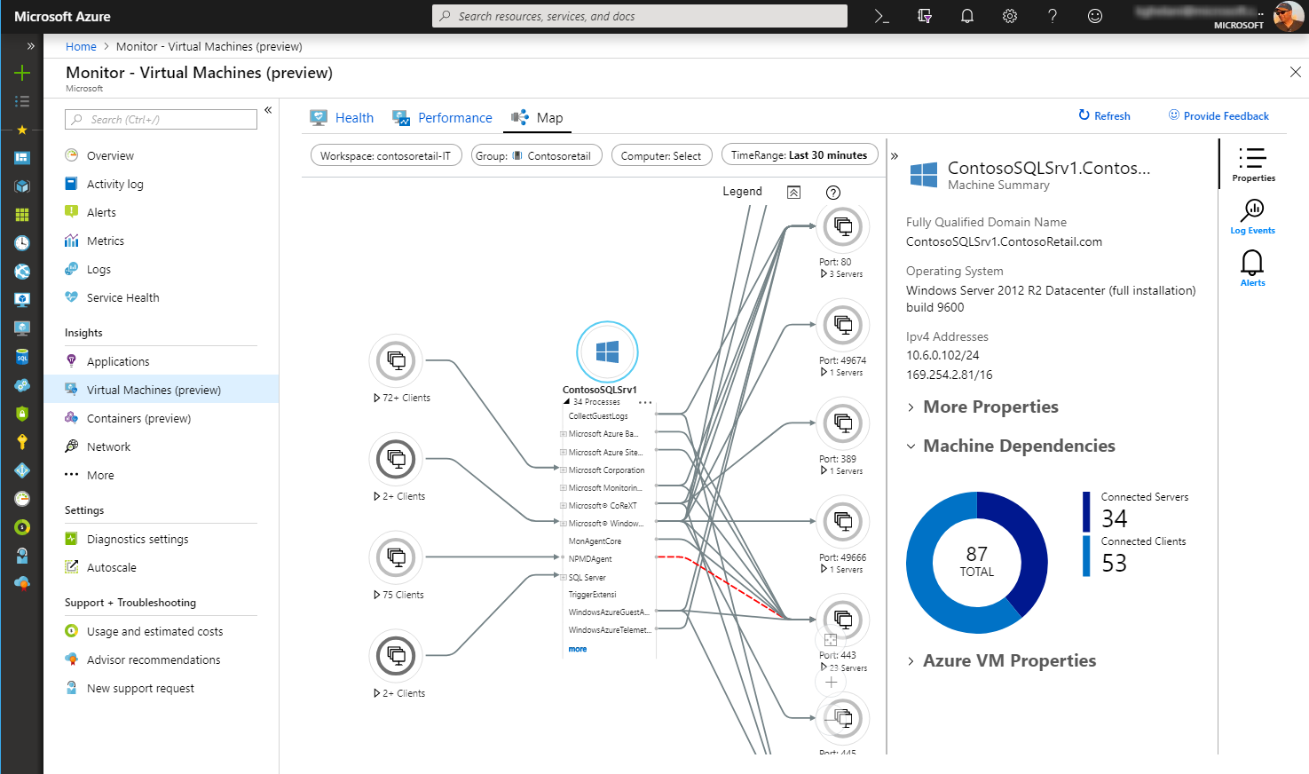
Azure Monitor for VMs
Maps
Visualize VMs and process interaction for resource groups, VM scale sets and subscriptions
Identify surprise dependencies and connection failures
Live connection metrics between processes and VMs identifying spikes in network traffic
Drill through dependent VMs to Alerts and Logs

Slide 9
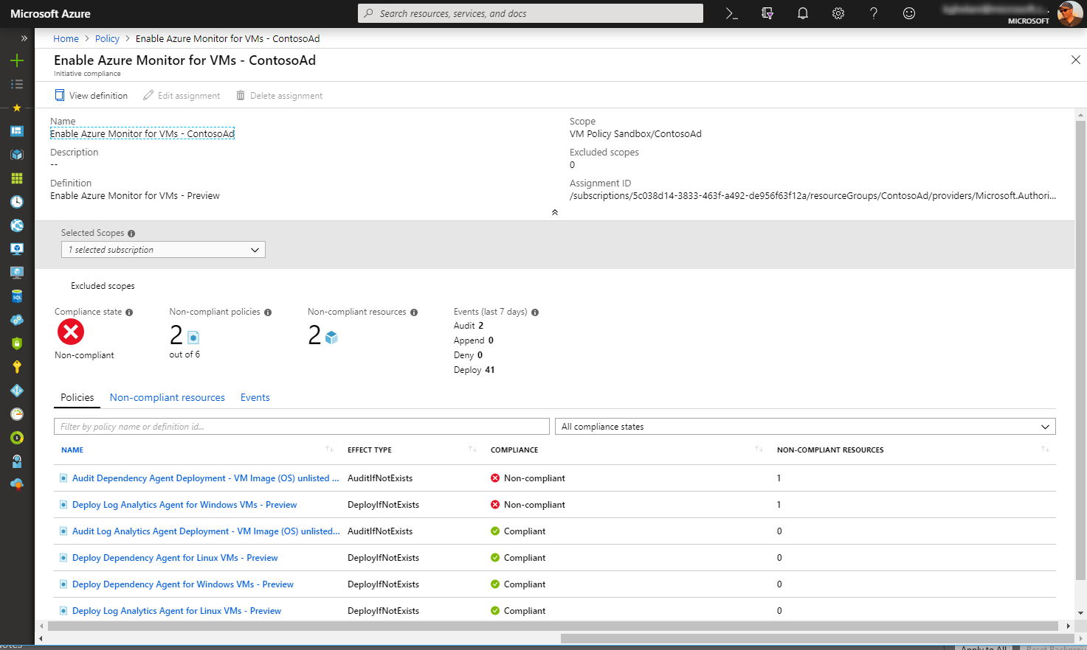
Azure Monitor for VMs
On boarding
Built-in monitoring policy to on board Azure VMs @ scale
Policy supports existing VMs and new VMs created
Remediation policy to on board VMs falling out of compliance

Slide 10
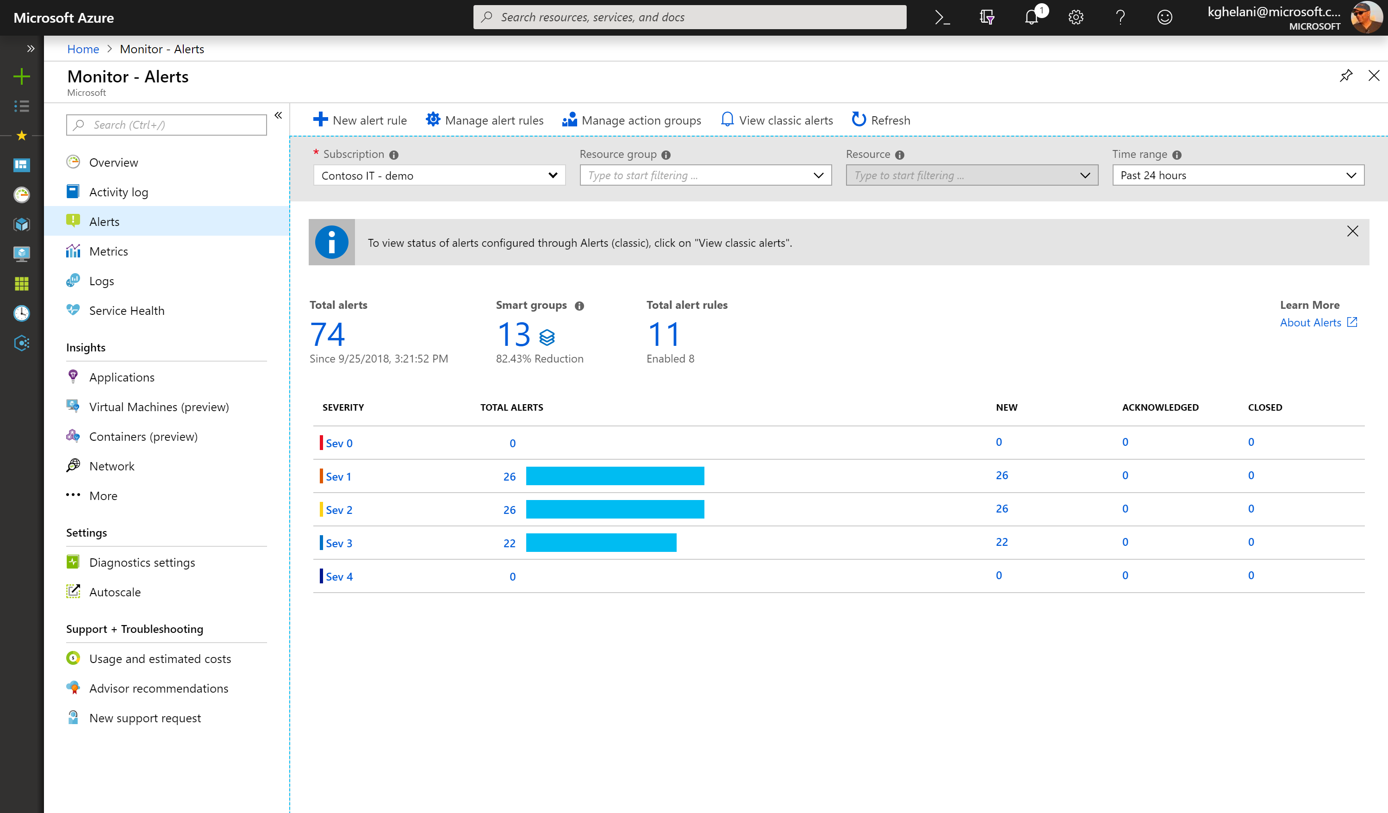
Azure Monitor Alerts
Just got better
One Alert Mgmt experience
Configure Alerts at Scale Multi-resource alerting
Unified Alert lifecycle Management
Smart grouping to reduce noise
Dynamic threshold base Alerting

Slide 11
Demo
Azure Monitor for VMs

Slide 12
Azure Monitor for Containers (AKS)

Slide 13
Common Container Monitoring Pain points…
Is my cluster healthy?
“I am having an issue
with my application but cannot find any issues?“
“many tools have nice graphs but does not
help where to go to troubleshoot next”
“I want to dig within the cluster but have filter to focus on my workloads.”
Troubleshooting Guidance
Drill down experience with filters
“if I am using Azure, can Microsoft provide monitoring tools for me?”
“I don’t want my devs to touch kubectl commands. It is another tool with additional learning.”
Lower
Maintenance
Cost
Native Monitoring Experience
Usability and
Control
“I know OSS monitoring products, but I want to focus on my products rather maintaining monitoring tools.”

Slide 14
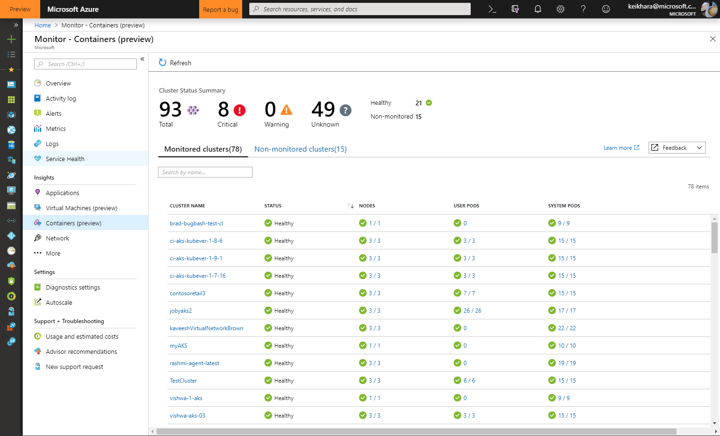
Azure Monitor for Containers
Public Preview in May //build 2018
Enhancements
Cross subscription multi-cluster health roll up view
NEW!
View overall health and perf across nodes, controllers and containers
Drill down monitoring experience with namespace, service, and node filters
Analyze Kubernetes event & container logs for troubleshooting
Monitor containers on demand for AKS with virtual nodes NEW!
Integrated in Azure DevOps Project
NEW!

Slide 15
Container monitoring Demo

Slide 16
Azure Monitor Logs (aka Log Analytics)

Slide 17







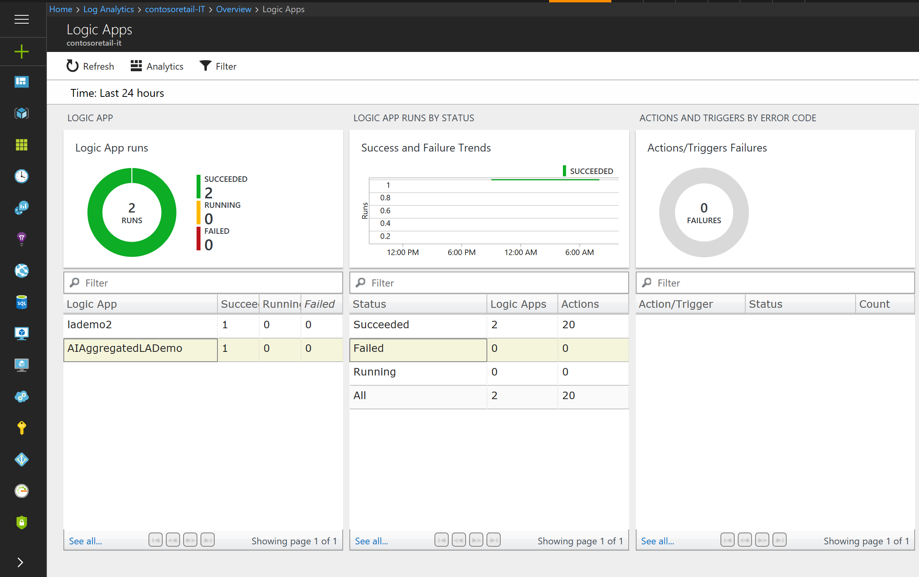
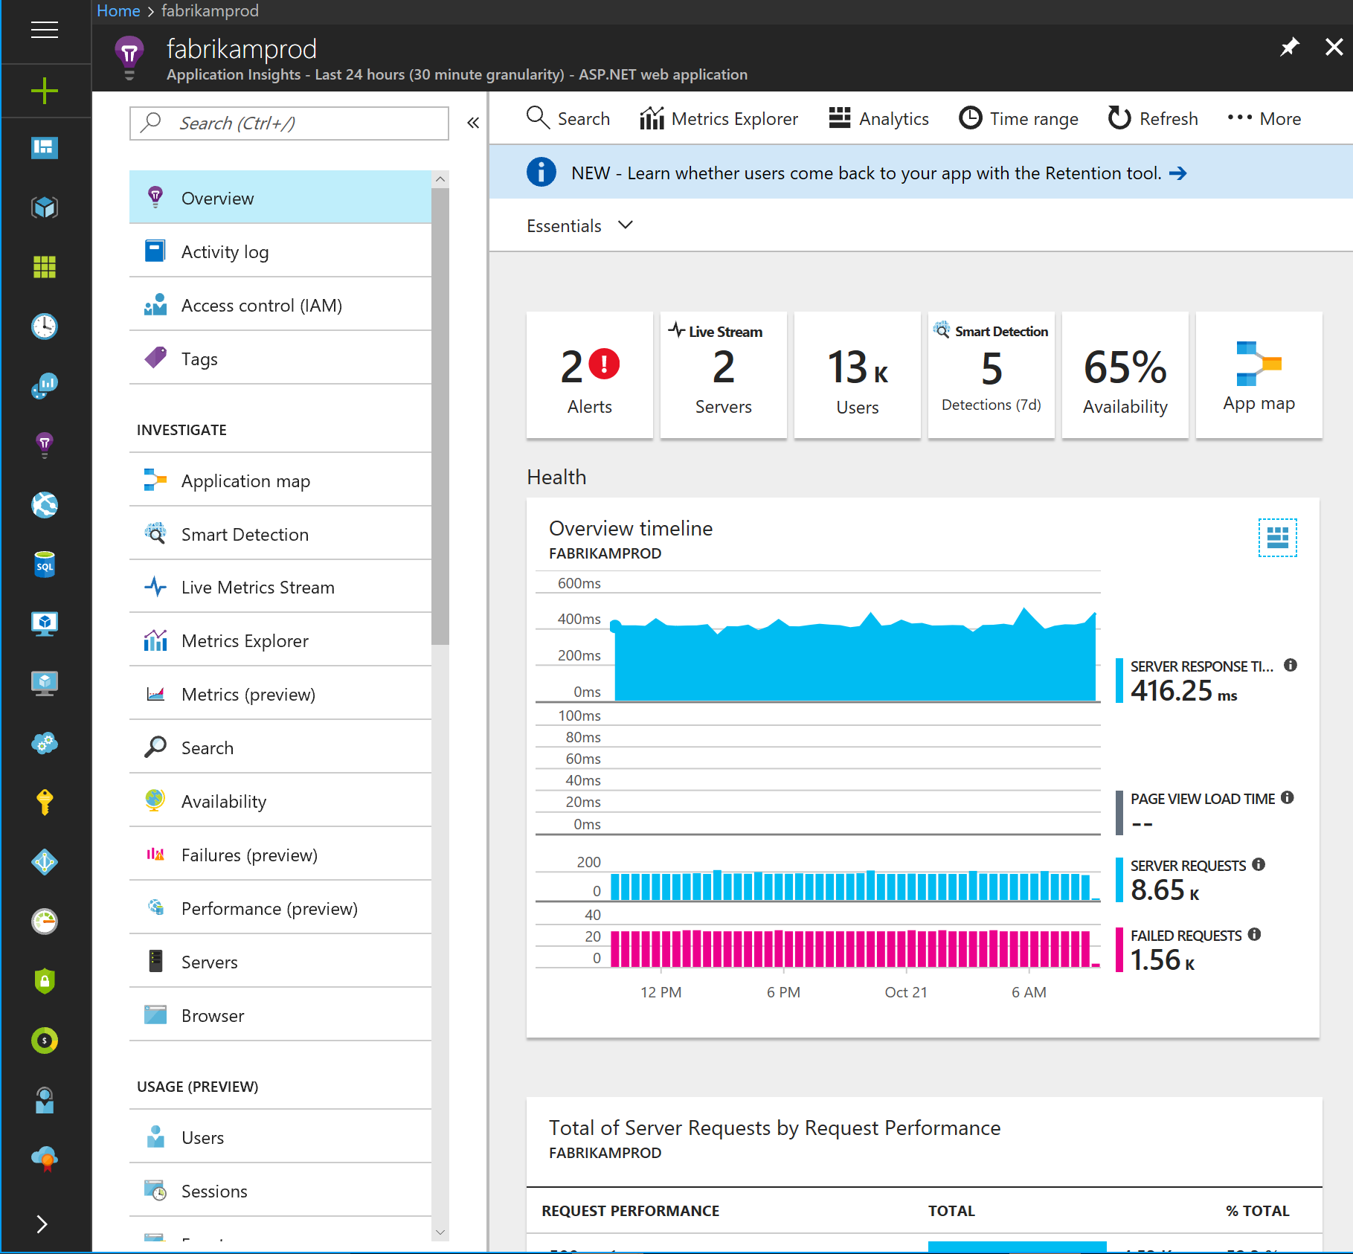
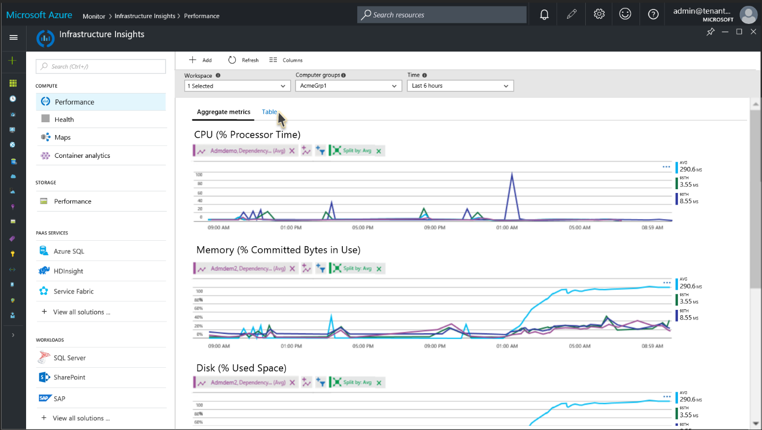
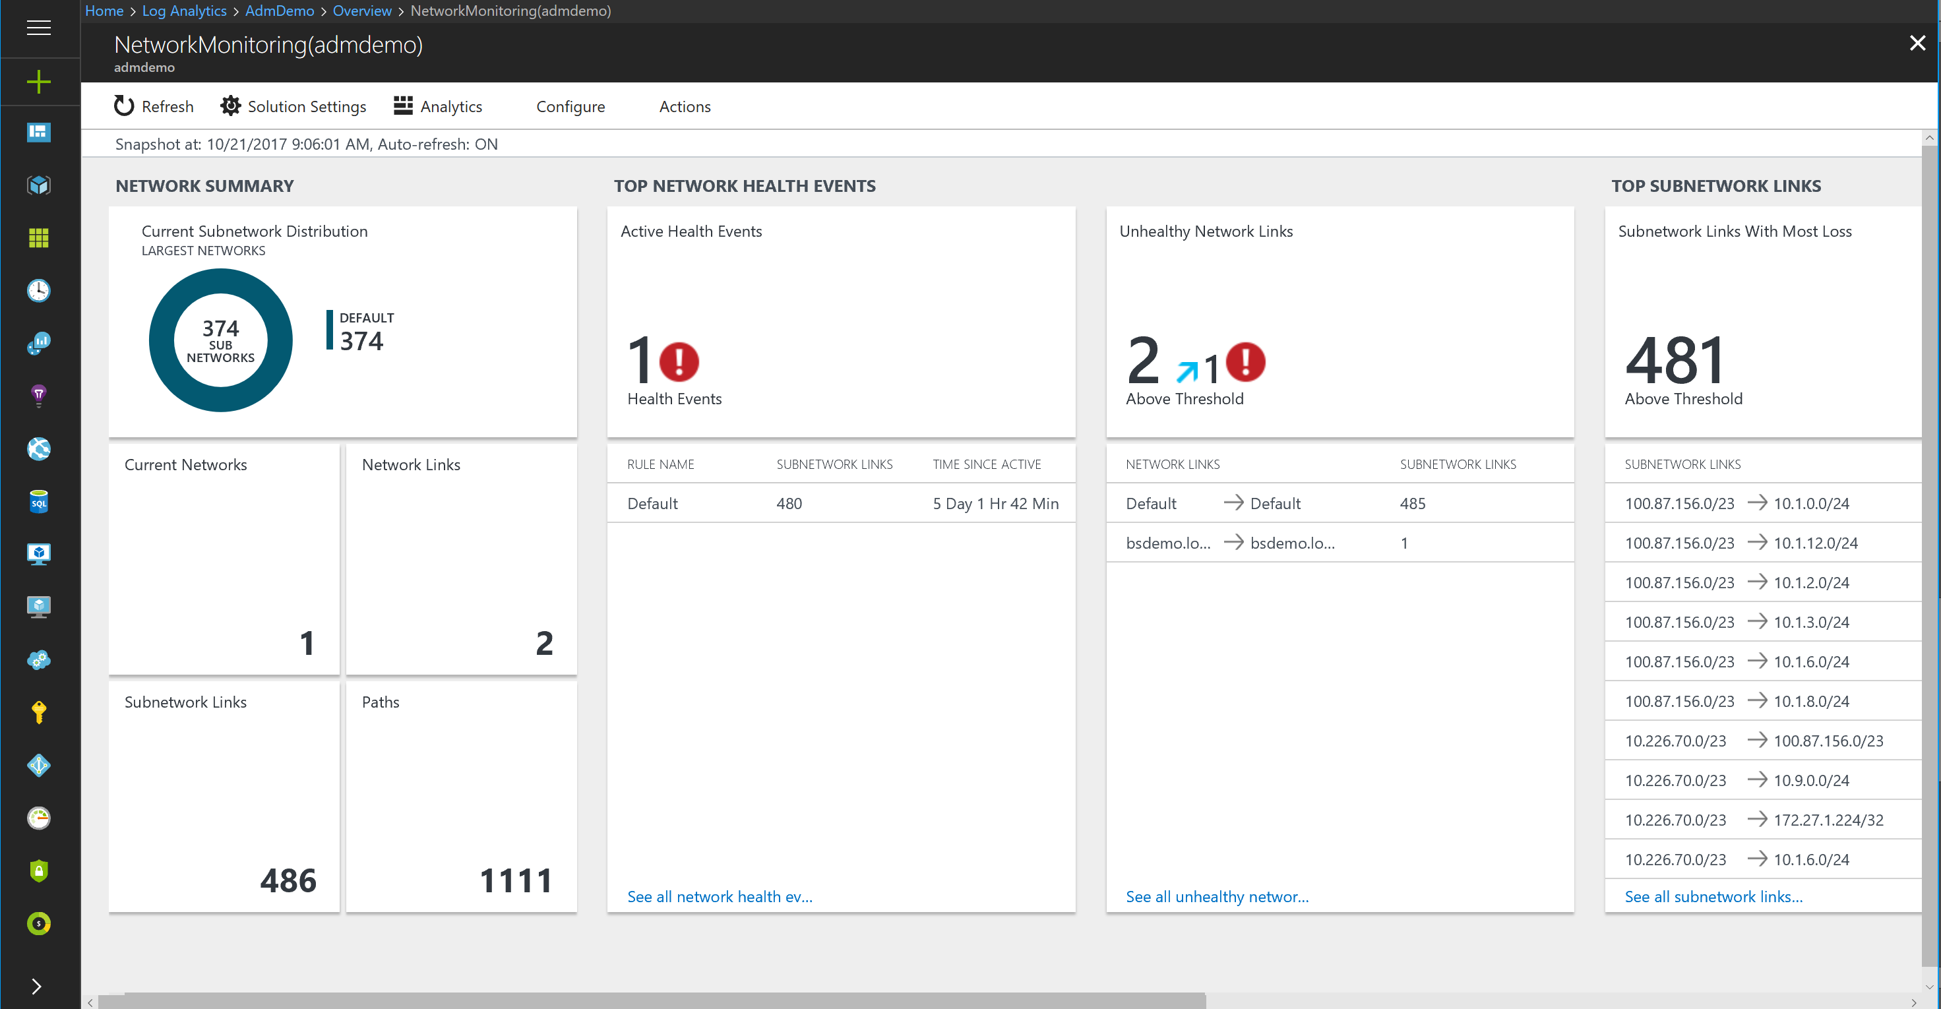
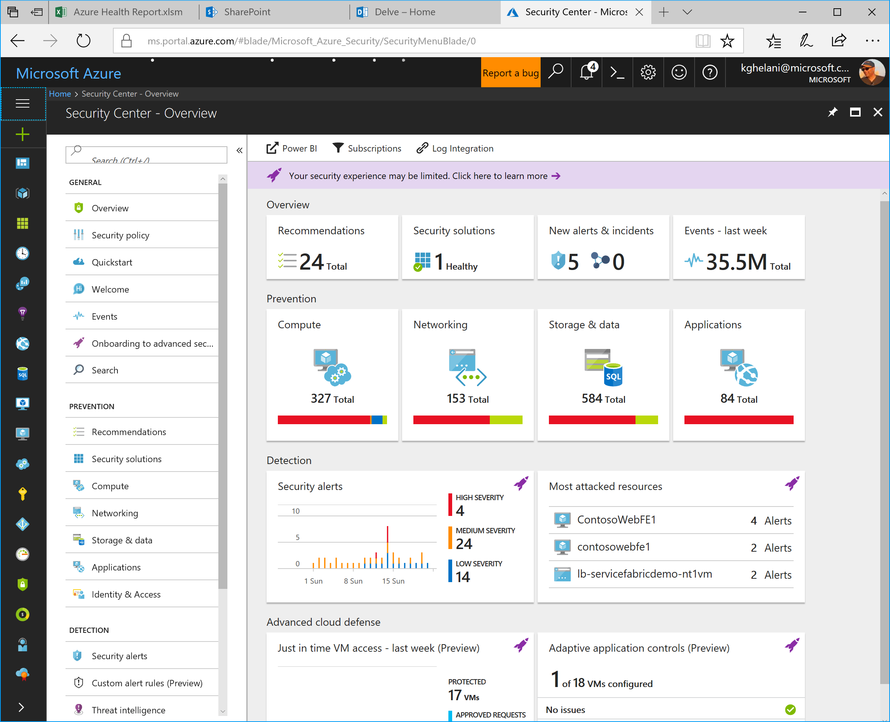


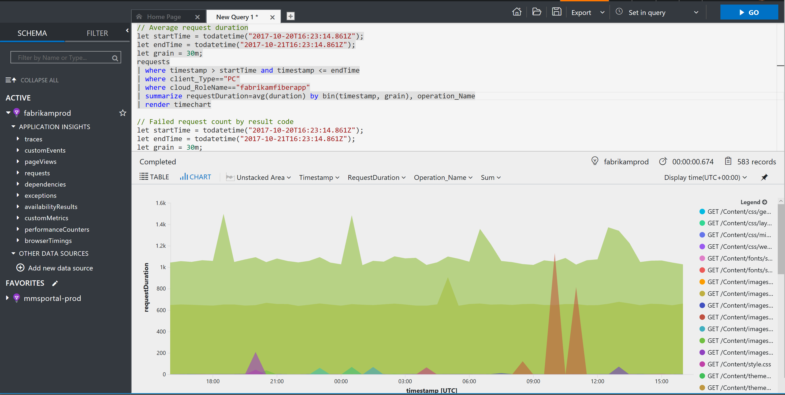






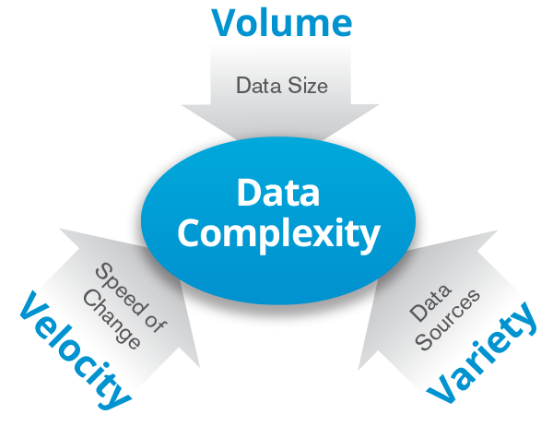
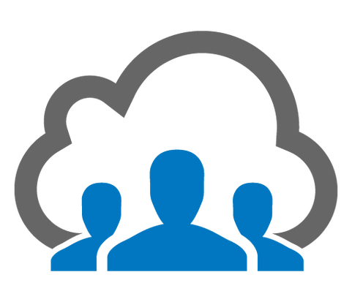
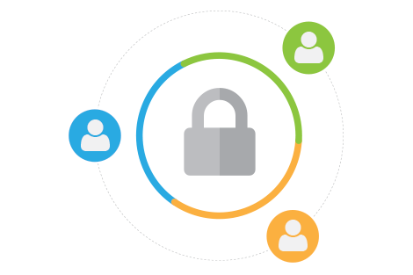
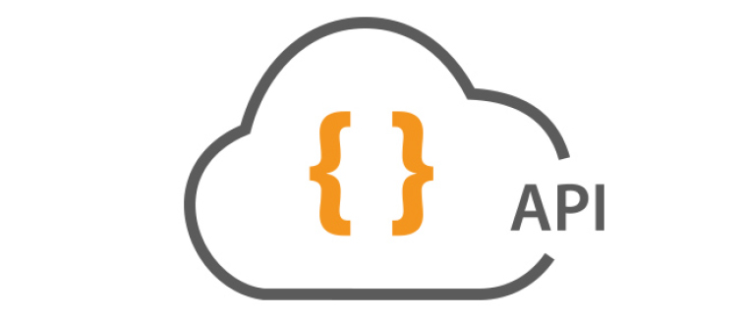
Azure Log Analytics
Powered by Kusto
Targeted Insights
Solutions
IoT
Dev
Ops
SecOps
NwOps
Multiple
Azure Time Series Insights
Context based experiences
Data
Explorers
Core
experiences
Multi Tenant
SaaS Platform
Azure Log Analytics
Scalable Big Data Platform
Kusto

Slide 18


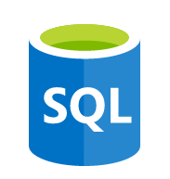




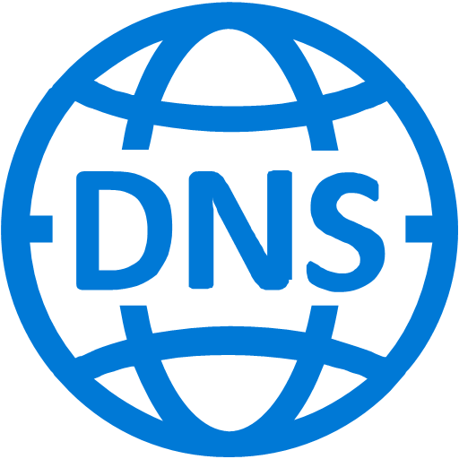
App
frontend
Real-time correlation
and analytics
Middleware
Application
Insights
Backend
Built-in operational
visibility
Operating
system
Data ingestion and correlation
Linux Server
Microsoft Azure
Log
analytics
Virtual
machine
Flexible turn-key integrations
Networking
Monitor
Virtual network
Load balancer
DNS
Actionable app-aware insights

Slide 19
Simple and unified experience
COLLECT AND
INDEX DATA
SEARCH AND
INVESTIGATE
MONITOR
AND ALERT
UNIFIED
EXPERIENCE
Expand your enterprise management with a consistent experience
CORRELATE AND ANALYZE
VISUALIZE
AND REPORT
Single platform for overall management
Leverage existing management platform
Access anywhere with a consistent user experience
Single pane of control
Unified experience
Integrate with existing systems
Connect with isolated resources
Control from anywhere
Consistent user interface
Notes:
Connect with all OMS capabilities within a single dashboard
Single pane of control for configuration, automation, monitor, protect, security
Leverage existing management platform (No rip and replace)
System Center, Zabbix, Nagios integration
OMS Gateway
Forward custom logs
Access anywhere with the same look and feel through your mobile
Mobile application for iPhone, Android and Windows Phone
Consistent user experience across OMS and Azure services

Slide 20



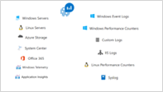

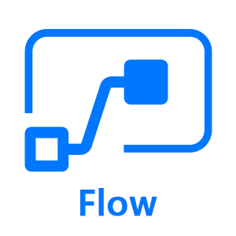

Azure Log Analytics Ecosystem
Ingestion
Exploration
Export & Correlation
Microsoft Monitoring Agent
Microsoft Azure Portal
Advanced Analytics Portal
Azure Monitor
Service Map
Application Insights Connector
Power BI
Azure Extensions
Data Collector APIs
Linux
Blob storage
Microsoft Flow
SCOM MP
Data Access REST APIs
Solutions
Security & Audit
Antimalware
Azure Activity Logs
Update Management
Azure Automation
Change Tracking
Wire Data
Network Performance Monitoring
Office 365
Azure SQL Analytics
Azure Containers
Upgrade Compliance
Upgrade Readiness
Device Health
Service Map
Alert Management
Capacity Management
HD Insights
SQL Assessment
AD Assessment
SQL Assessment Plus
Exchange Assessment
SP Assessment
VMWare
Azure App Gateway
Azure NSG Analytics
Key Vault Analytics
MORE….
…

Slide 21






UNIFIED EXPERIENCE
COLLECT AND INDEX DATA
SEARCH AND INVESTIGATE
CORRELATE AND ANALYZE
VISUALIZE AND REPORT
MONITOR AND ALERT
Windows agents
SCOM
Linux / FluentD
Log Analytics
REST Collection API
Sample list of log/metrics that OMS collects:
Custom Application/Infra logs
Windows event logs
Window performance counters
Security Event Logs
IIS Logs
ETW logs
Azure Diagnostics
SaaS services
O365
Azure Storage /
Azure Diagnostics
Event Hub
Log Stash

Slide 22
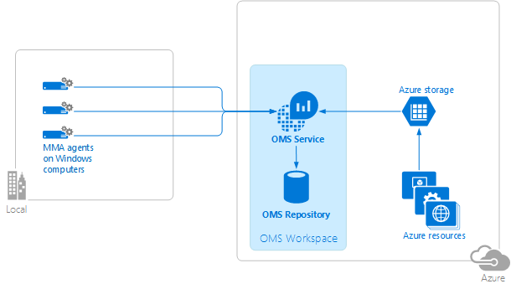
UNIFIED EXPERIENCE
COLLECT AND INDEX DATA
SEARCH AND INVESTIGATE
CORRELATE AND ANALYZE
VISUALIZE AND REPORT
MONITOR AND ALERT
Windows agents
Log Analytics
Connect to Windows computers in your on-premises infrastructure directly to OMS workspaces by using a customized version of the Microsoft Monitoring Agent (MMA).
https://azure.microsoft.com/en-us/documentation/articles/log-analytics-windows-agents/

Slide 23
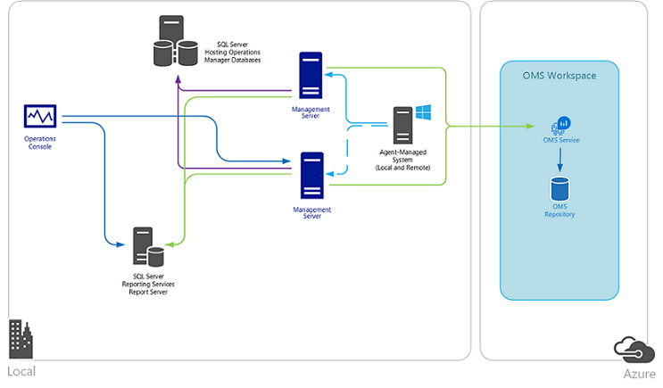
UNIFIED EXPERIENCE
COLLECT AND INDEX DATA
SEARCH AND INVESTIGATE
CORRELATE AND ANALYZE
VISUALIZE AND REPORT
MONITOR AND ALERT
SCOM
Log Analytics
Integrate Operations Manager with your OMS workspace to:
Continue monitoring the health of your IT services with Operations Manager
Maintain integration with your ITSM solutions supporting incident and problem management
Manage the lifecycle of agents deployed to on-premises and public cloud IaaS virtual machines that you monitor with Operations Manager

Slide 24
UNIFIED EXPERIENCE
COLLECT AND INDEX DATA
SEARCH AND INVESTIGATE
CORRELATE AND ANALYZE
VISUALIZE AND REPORT
MONITOR AND ALERT
Linux / FluentD
Log Analytics
Collect and act on data generated from Linux computers. Adding data collected from Linux to Log Analytics
allows you to manage Linux systems and container solutions like Docker regardless of where your computers are located—virtually anywhere.
Upload data (HTTPS)
omsagent (FluentD)
syslog
OMS Service
Firewall/proxy
OMI Server
(CIM Server)
Nagios
Operating System
Providers
Apache
Zabbix
MySQL
Containers
Docker
omsconfig (DSC)
Pull configuration
(https)
PS DSC
Linux Computer

Slide 25







UNIFIED EXPERIENCE
COLLECT AND INDEX DATA
SEARCH AND INVESTIGATE
CORRELATE AND ANALYZE
VISUALIZE AND REPORT
MONITOR AND ALERT
Linux / FluentD
Log Analytics
Supported Linux platform
6.x 32/64-bit 7.x 32/64-bit 8.x 32/64-bit
5.x 32/64-bit 6.x 32/64-bit 7.x 64-bit
5.x 32/64-bit 6.x 32/64-bit 7.x 64-bit
2013.09 – 2015.09
12.x 32/64-bit 14.x 32/64-bit
15.x 32/64-bit 16.x 32/64-bit
alpha
beta
stable
10.x 32/64-bit 11.x 32/64-bit
12.x 64-bit
5.x 32/64-bit 6.x 32/64-bit 7.x 64-bit

Slide 26
UNIFIED EXPERIENCE
COLLECT AND INDEX DATA
SEARCH AND INVESTIGATE
CORRELATE AND ANALYZE
VISUALIZE AND REPORT
MONITOR AND ALERT
REST Collection API
Log Analytics
Leverage REST collection API to ingest custom data to Operations Management Suite
Post json document to HTTPS endpoint
Ensure json is flattened and not nested
$json = @"
[{ "slot_ID“ : 12345,
"ID“ : "5cdad72f-c848-4df0-8aaa-ffe033e75d57",
"availability_Value": 100,
"measurement_Name“ : "last_one_hour",
"duration“ : 3600,
"ExecutionTime“ : "2016-05-12T20:00:00.625Z"
},
{ … }]
"@
Authenticated using workspace key to hash content
API
Log Search API Create, manage and run searches Alert API Create and manage alerts
Powershell
Log Analytics cmdlets Nouns ComputerGroup IntelligencePacks (solutions) LinkTargets SavedSearch SavedSearchResults StorageInsights Workspace WorkspaceManagementGroups WorkspaceSharedKeys WorkspaceUsage
Notes:
OMS Linux agent (Syslog using fluentd and collectd)
https://blogs.technet.microsoft.com/msoms/2016/05/12/syslog-collection-in-operations-management-suite/
Use collectd to bring metrics into OMS Log Analytics
https://blogs.technet.microsoft.com/msoms/2016/07/14/bring-your-custom-collectd-metrics-into-the-oms-log-analytics-platform/
Linux and Docker management
https://blogs.technet.microsoft.com/momteam/2015/11/03/announcing-linux-docker-container-management-with-oms/
Monitor VMWare using OMS Log Analytics (custom logs)
https://blogs.technet.microsoft.com/msoms/2016/06/15/monitor-vmware-using-oms-log-analytics/
HTTP Ingestion API
Documentation
https://onedrive.live.com/redir?resid=E6DDF48D2F1DA0EB!7047&authkey=!AEjZIm-nLuLvzgU&ithint=folder%2cdocx
Use your favorite language
Client-side bindings for c#, .NET, node js, Powershell, python
Custom data into OMS Log Analytics
https://blogs.technet.microsoft.com/msoms/2016/07/21/bring-your-custom-json-data-to-log-analytics-oms-with-twitter-data-example/

Slide 27
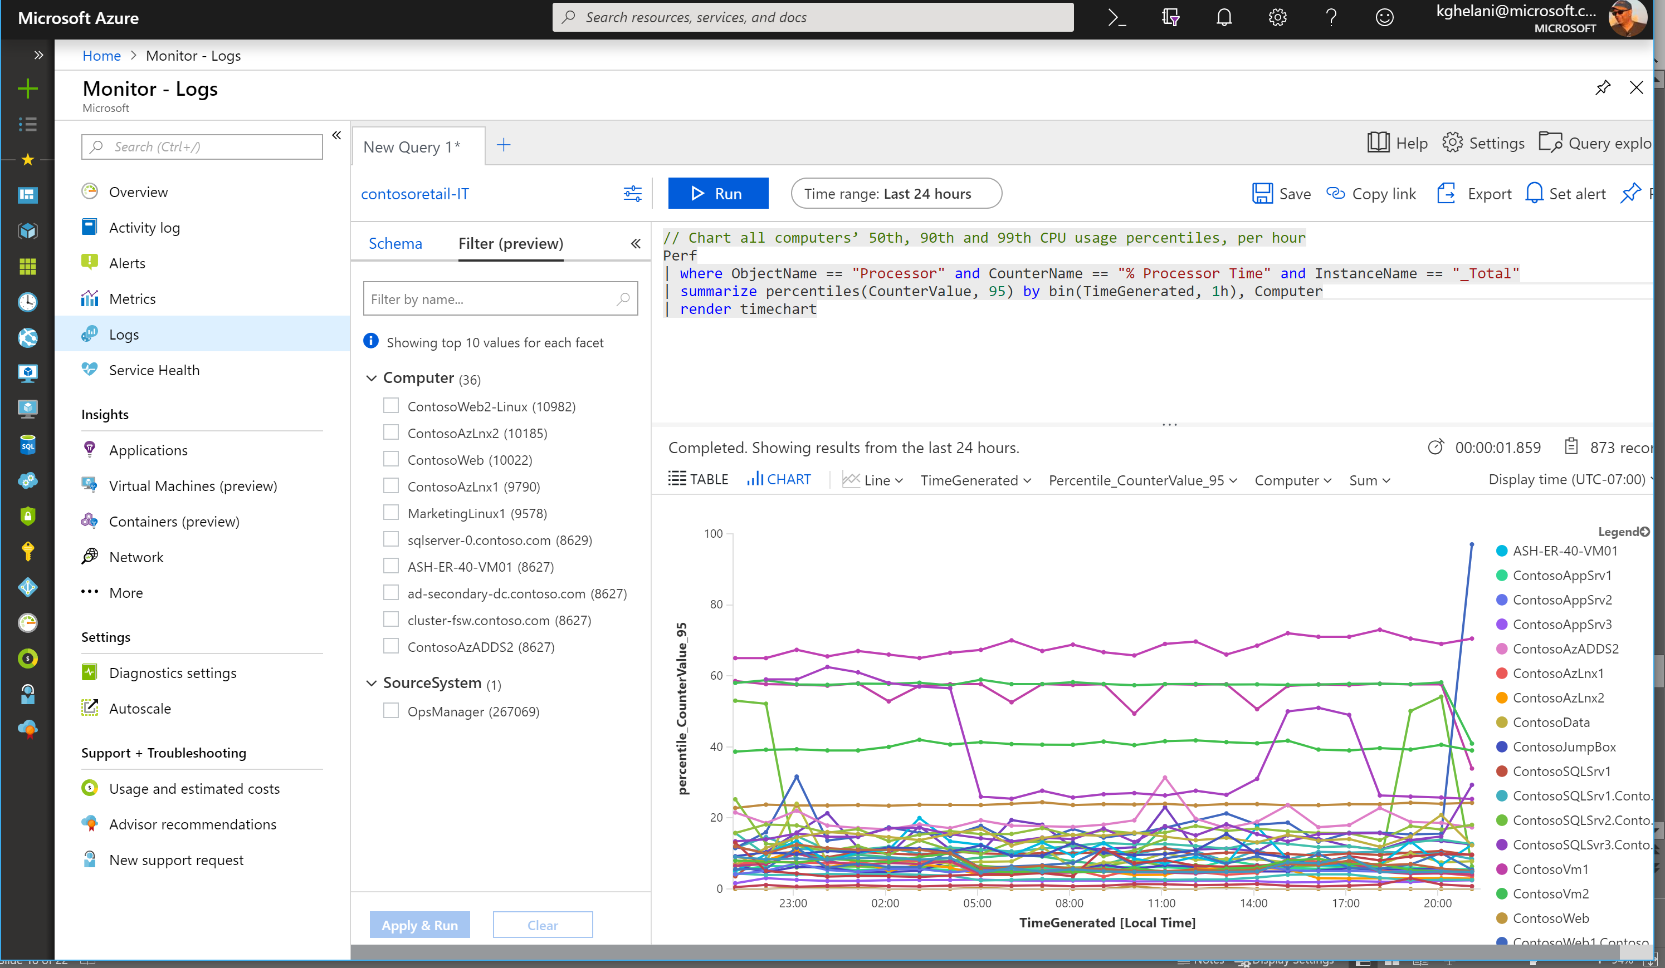
Azure Monitor Logs
Log Analytics
Log Analytics advanced query experience now in Azure Portal
RBAC per type
Run analytics queries for investigations, statistics, and root cause + trend analysis
Utilize ML algorithms for clustering and anomaly detection
Training: http://aka.ms/kqlpluralsight

Slide 28
Azure Monitor Logs Log Analytics Demo

Slide 29
Recap
Azure Monitor for VMs
Azure Monitor for Containers
Azure Monitor Logs
Monitor VMs @ Scale
Identify & isolate host-level or guest-level health problems
Visualize service dependencies & connection failures in Maps
On board VMs at Scale using PowerShell and/or Azure Policy
Monitor multi-cluster health & node/pod status
Monitor containers on demand in AKS with virtual nodes
Drill through Kube events
On board monitoring using az aks cli commands
Log Analytics advanced query experience now in Azure Portal
Utilize ML algorithms for clustering and anomaly detection
RBAC per type
http://aka.ms/kqlpluralsight

Slide 30
Azure Monitor Roadmap
Rich insights for Azure Storage, SQL & Service Fabric Mesh
RBAC per data type in Log Analytics
Support for containers on demand for AKS with virtual nodes
Support live logs for containers and Kubernetes events
Smart detections and alerts with Dynamic Thresholds
Expanded Azure support and interoperability for Distributed Tracing
Exception tracking and custom metrics for Python and Go apps
Auto enablement of app monitoring for App Services / Windows VMs (with WAD)
Expanded region availability across public & sovereign clouds
Latency improvements for Alerts, Logs & Metrics

